Slide 1

AI-Powered Digital Twin & Predictive Maintenance
For Small & Medium Manufacturing Enterprises
Transforming downtime into productivity.
The future of affordable, intelligent maintenance has arrived.

Slide 2
A Day in the Life: An MSME Owner's Challenge
Meet Rakesh
Owner of a small manufacturing unit in Pune with 15 employees and limited resources. His primary CNC machine suddenly fails during a critical production run.
Production halts completely. Orders are delayed. Costs pile up. Technical support is days away, and replacement parts will take weeks to arrive.
For Indian MSMEs like Rakesh's, this isn't a rare scenario—it's a routine reality.
Production Loss
Customer Trust
Repair Costs
₹40,000 per day in direct production losses
Delayed orders damage hard- earned reputation
Emergency repairs cost 3x regular maintenance

Slide 3





The Problem: Unplanned Downtime Costs MSMEs Billions
72% 11%
3x
of MSMEs experience monthly equipment breakdowns
of annual revenue lost due to unplanned downtime
higher cost for emergency repairs vs. preventive
maintenance
Most small manufacturers rely on reactive, manual maintenance practices—creating a costly cycle of stress, lost opportunity, and preventable expenses.
Equipment Fails Without Warning
Emergency Repair Costs Spike
Cycle Repeats Without Prevention
Production Comes to a Halt

Slide 4
Market Opportunity: A Massive and Urgent Need
6.3 Cr
MSMEs in India
India's MSME Landscape
India has a thriving MSME sector that forms the backbone of our industrial ecosystem. With 6.3 crore MSMEs nationwide, including 11-15 lakh in manufacturing, the need for accessible smart manufacturing solutions is critical.
₹1200 Cr+
Industry 4.0 Market by 2027
The Industry 4.0 and predictive maintenance market is projected to reach ₹1200 crore+ by 2027, driven by government initiatives like PLI, SAMARTH Udyog, and urgent operational demands.
11-15 Lakh
Manufacturing MSMEs
Untapped Market
Cost Savings
Government Support
86% of MSMEs still rely on reactive maintenance practices
11% of annual revenue lost to unplanned downtime
PLI & SAMARTH schemes accelerating Industry 4.0 adoption

Slide 5
Market Validation: MSMEs Speak Out
Survey of 50 MSMEs across manufacturing sectors reveals clear pain points and market needs:
72%
86%
68%
face monthly equipment downtimes affecting production
rely on reactive maintenance after failures occur
seek affordable monitoring solutions for equipment
Demand for accessible, cost-effective predictive maintenance solutions is clear and growing across Indian manufacturing MSMEs.

Slide 6





Our Solution: Affordable, Smart, MSME-Friendly
Introducing ISF's AI-Powered Digital Twin & Predictive Maintenance System:
Plug-and-play, affordable for any MSME
Real-time IoT monitoring of critical equipment metrics
ML-powered anomaly detection catches issues before they cause failures
Digital twin simulation & actionable alerts for proactive response
All on a user-friendly cloud dashboard accessible anywhere

Slide 7



How It Works: Simple, Powerful Technology
Our affordable AI-powered system transforms complex industrial data into simple, actionable insights - no technical expertise required.
Easy Setup
Plug-and-play installation in under 30 minutes
Mobile Access
Monitor from anywhere on any device
Secure Data
End-to-end encrypted data protection
Performance Reduce downtime by up to 30%
IoT Sensors Track Equipment 24/7
Real-time Data Flows to Cloud
AI & ML Detect Issues Early
Digital Twin Simulates Outcomes
Instant Alerts & Guidance

Slide 8
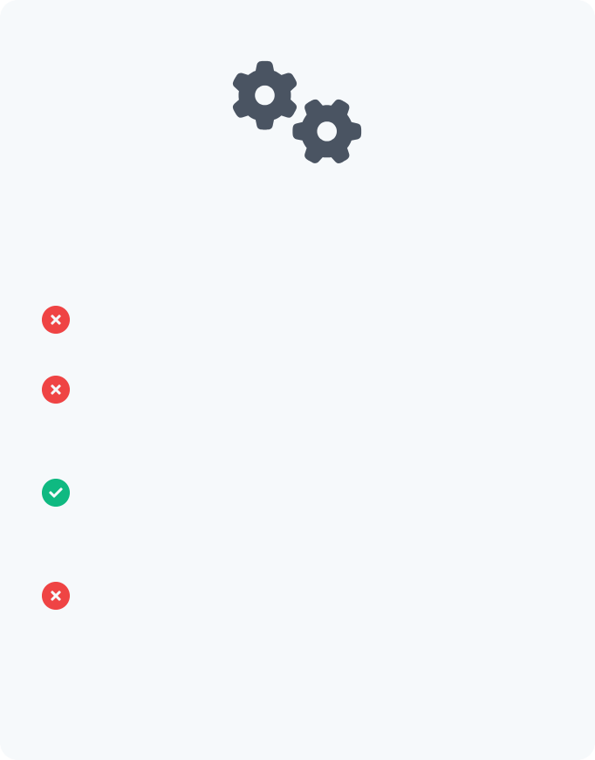


Competitive Landscape: Our Edge vs. Global Giants
Most Prominent
Siemens MindSphere
ISF Solution
Bosch Phantom Edge
Designed for enterprise-scale operations
Affordable plug-and-play system for small manufacturers
Limited customization options
Vendor lock-in with proprietary systems
Complex implementation requiring IT expertise
No technical expertise required to set up & operate
Moderate complexity implementation
High initial investment & ongoing costs
Customizable for specific MSME machinery needs
Not optimized for small-scale operations
Long onboarding & training periods
Quick deployment with same- day insights
Cost Efficiency
Implementation Speed
Indian MSME Focus
10 x more affordable than enterprise solutions while delivering core predictive capabilities
Setup in hours, not weeks or months, with no specialized technical staff required
Built specifically for local manufacturing environments and machinery types

Slide 9

Business Model: B2B Sales, Scalable SaaS
Go-to-Market Strategy
Direct B2B sales to MSMEs through industry associations, demo days, and state MSME board partnerships. Focused on high-impact sectors: auto parts, textile, plastics, and fabrication workshops.
Starter Kit Hardware
Subscription Analytics
ML Add-on Package
Affordable plug-and-play hardware units with essential IoT
sensors and edge computing capabilities. Volume pricing for multi-machine operations.
Monthly cloud-based dashboard with real-time
monitoring, predictive alerts, and maintenance optimization recommendations.
Premium digital twin simulation features, advanced anomaly
detection, and customized predictive models for specific machinery types.
Expansion Strategy
Strategic partnerships with MSME support agencies, industrial equipment OEMs, and regional maintenance service providers. Expand offerings through technical support contracts and industry-specific ML models.

Slide 10
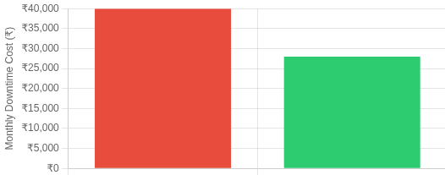
Financial Projections & ROI
Pricing Model Customer ROI Impact
Hardware Unit
₹7,500
One-time purchase per machine monitored
Analytics Subscription
₹500/month
Cloud dashboard, alerts, digital twin access
30%
20%
15x
Enterprise Package
Reduction in unplanned downtime
Increase in machine lifespan
Return on investment (1st year)
Custom Pricing
For multi-location deployments (10+ units)
Scalable Revenue Model: Our recurring subscription model creates long-term value while remaining affordable for MSMEs. With India's 11-15 lakh manufacturing MSMEs as our target market, capturing just 1% would yield ₹4.5+ crore in annual recurring revenue.

Slide 11




Development Roadmap
1
2
3
4
MVP Pilot
Scale Production
Regional Expansion
Long-Term Growth
Q1-Q2 2026
Q3-Q4 2026
Q1-Q3 2027
2028+
Phase 1: MVP Pilot
Phase 2: Scale Production
Phase 3: Expand Reach
Long-Term Vision
Local MSME testing
Basic IoT monitoring
Initial ML anomaly detection
Prototype hardware deployment
Advanced analytics integration
Expand platform ecosystem
Industry-specific solutions
Global market exploration
Scale hardware manufacturing
Add digital twin features
Improve ML algorithms
Launch cloud dashboard
Expand to 5+ states
Government/industry partnerships
Multilingual support
Enhanced API integrations

Slide 12




Our Ask: Join the Future of Smart Indian Manufacturing
Seeking investment and partners to scale ISF's impact:
Technology Enhancement — Advance our AI algorithms and digital twin capabilities for greater accuracy
Production Scaling — Manufacture more affordable units to reach thousands of MSMEs across India
Go-to-Market Strategy — Accelerate our reach through MSME associations and state partnerships
Partnership Opportunities — Collaborate for pilot deployments and MSME capacity building

